Slide 1
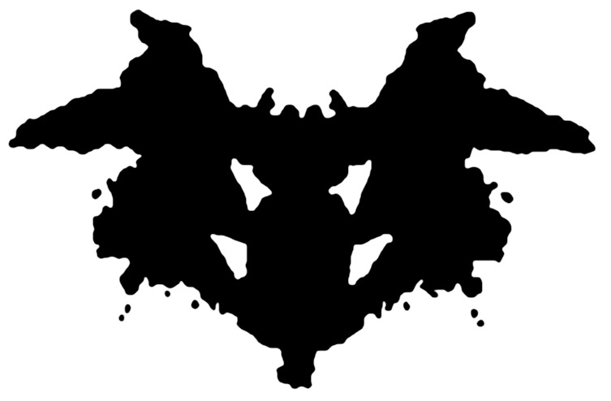
Therapeutic Orientations
[Instructor Name]
[Class Section Number]
Notes:
This module outlines some of the best-known therapeutic approaches and explains the history, techniques, advantages, and disadvantages associated with each. The two modules in this unit are ideally taught over two class periods, but can be compressed into one if need be.
Warm-up Discussion Topic: Think of movies or TV shows that depict therapy or therapist-client interactions. Were these portrayals positive or negative? How and in what way? What are some stigmas that tend to be associated with psychological treatment? If someone you knew were to seek treatment for social anxiety, do you think they would feel comfortable sharing this information? Why or why not?
Possible student answers: Many therapeutic encounters portrayed in movies, specifically, are humorous (as in the case of Billy Crystal and Robert Dinero in “Analyze This”) and in other cases therapists are portrayed in ways that are either unrealistic or are unethical. It is possible to ask students how media representations affect their view of therapy.

Slide 2
Overview
Introduction
Psychoanalysis and Psychodynamic Therapy
  Activity
Humanistic & Person-Centered Therapy
Cognitive Behavioral Therapy
  Activity
Acceptance and Mindfulness Approaches
Other Therapeutic Techniques
Notes:
This slide provides an overview of the material that will be covered during the lecture.
Technical Note: These slides may contain simple click animation so that you can focus students’ attention on a particular question, a selection of text, or an image and not have them be distracted by reading ahead. You can either preview the sequence of animation by going through the slides in slideshow view, visiting the animations tab, or reviewing the slide notes. In the notes you will see a cue - (Click) – that corresponds to each animation.
You will also find hyperlinks to outside videos at various places in the slides. These hyperlinks are embedded in text and indicated by color and in the notes section.

Slide 3
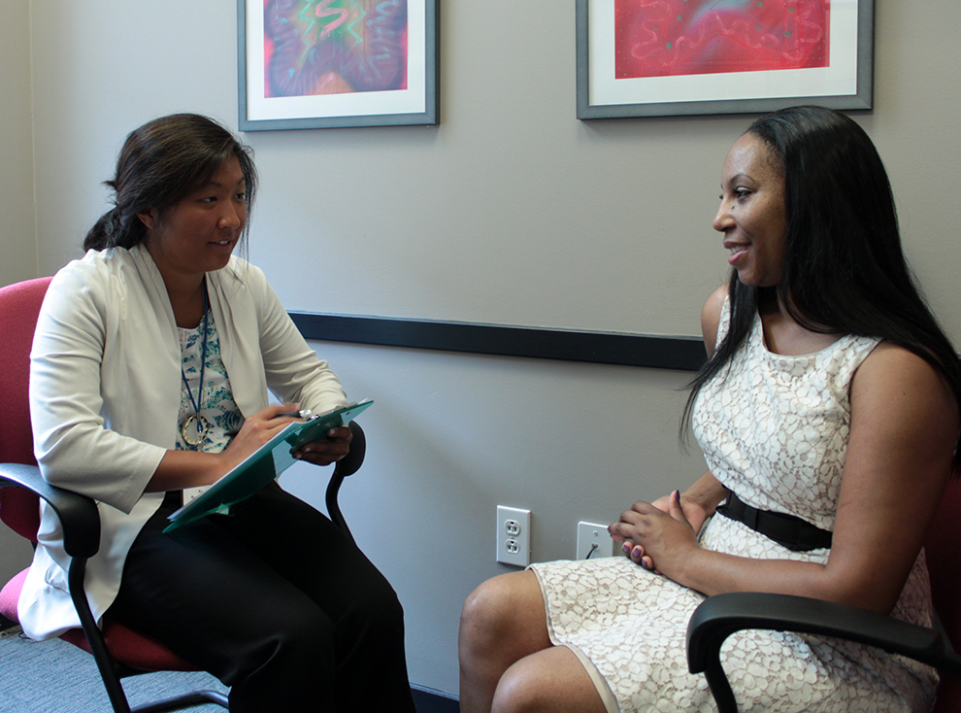
Introduction
Why is it important to know about psychotherapy?
Notes:
This slide encourages students to think critically about psychotherapy.
Discussion Question: Why is it important to have a basic understanding of psychotherapy?
Students may generate reasons such as: to understand the implications of a loved one’s counseling needs; because counseling is extremely common; it’s important to know what types of counseling might be best suited to their concerns.
Instructor’s Note: Students are very likely encounter psychological services at some point in their lives. In fact, nearly half of all American’s will experience mental illness.

Slide 4
Overview
Introduction
Psychoanalysis and Psychodynamic Therapy
  Activity
Humanistic & Person-Centered Therapy
Cognitive Behavioral Therapy
  Activity
Acceptance and Mindfulness Approaches
Other Therapeutic Techniques
Notes:
This slide provides an overview of the material that will be covered during the lecture.

Slide 5
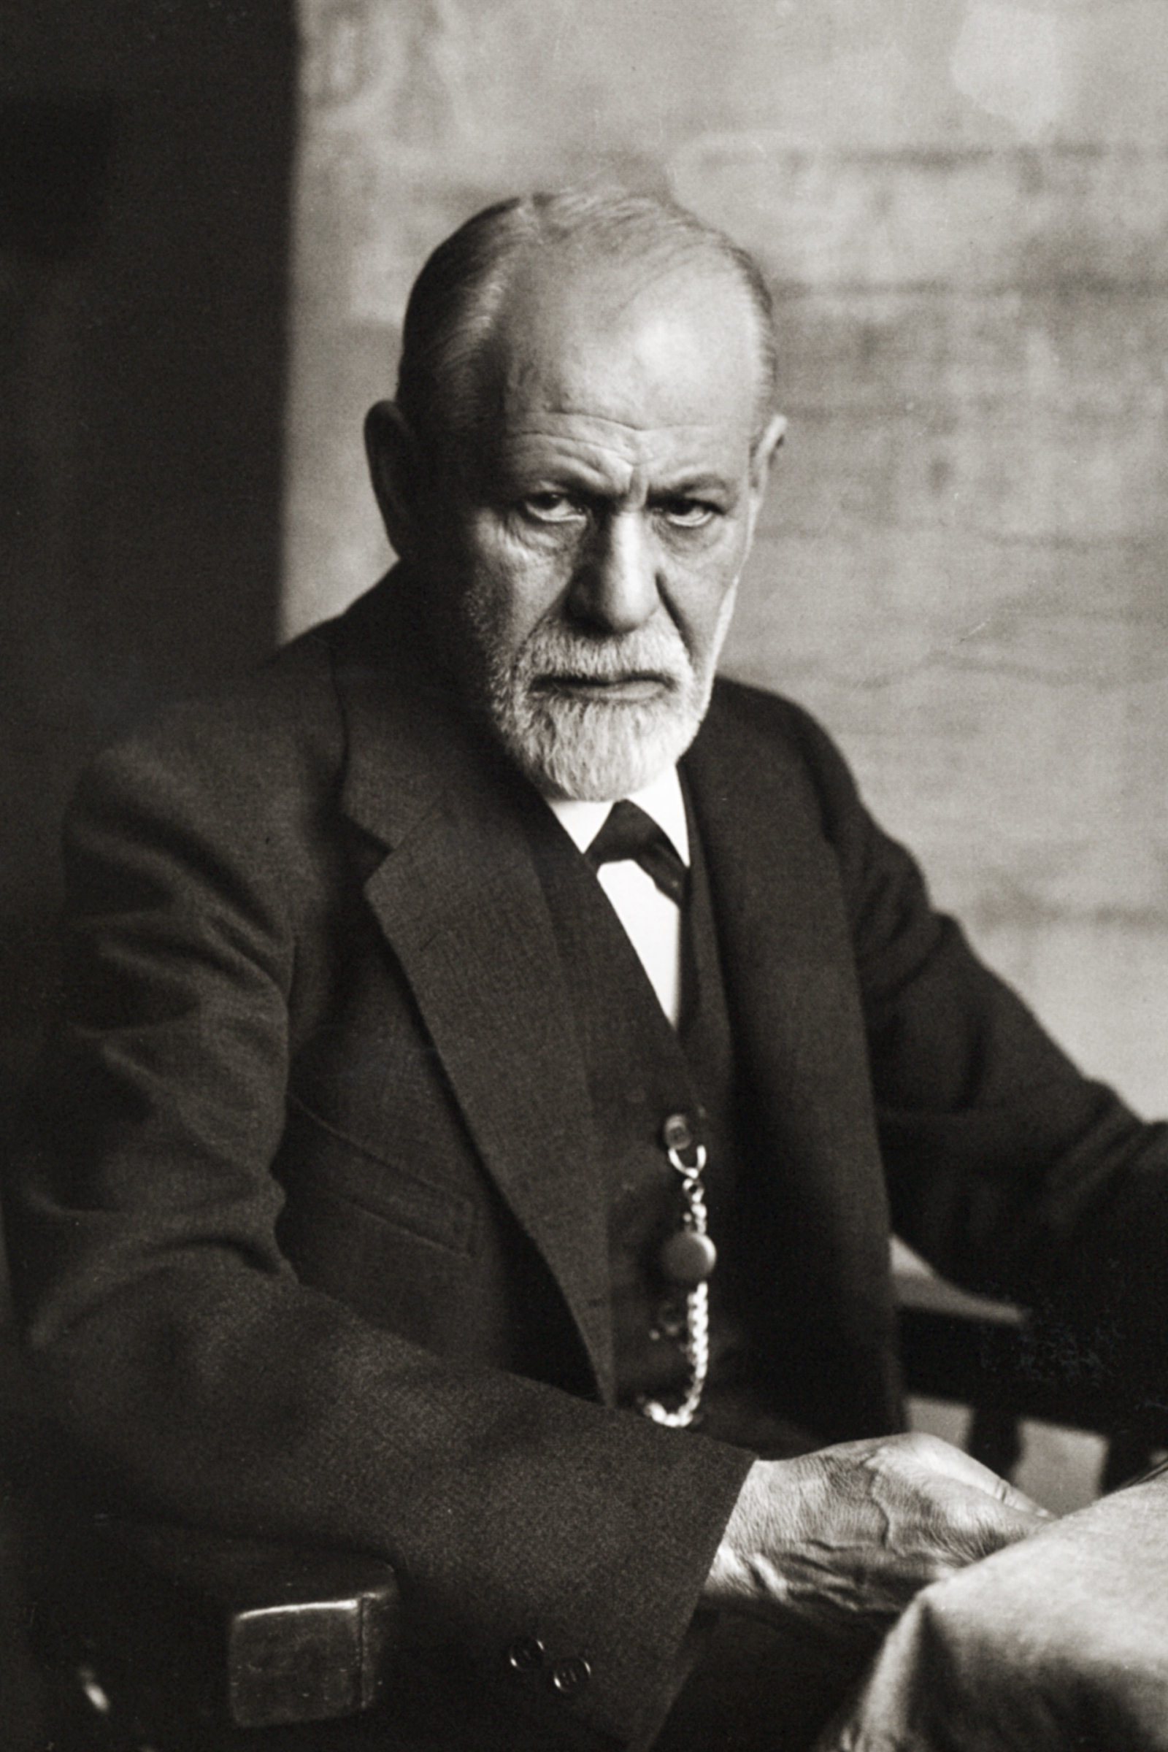
Psychoanalysis &
Psychodynamic Therapy
First organized therapy
Freud
Psychodynamic Therapy
Notes:
This slide introduces students to the concept of psychoanalysis and psychodynamic therapy.
Lecture Info:
Psychoanalysis was the first organized therapy for mental disorders. The psychoanalytic approach stresses that mental health problems come from unconscious conflicts and desires, which must be uncovered in order to resolve mental illness. Psychoanalysis also highlights the importance of early childhood experiences in determining mental health later in life. Psychoanalysis is an intensive, long-term approach in which patients and therapists may meet multiple times per week, often for many years.
Sigmund Freud is considered to be the founder of psychoanalysis. Initially, he suggested that mental health problems arose from efforts to push inappropriate sexual urges out of conscious awareness. Later, Freud suggested more generally that psychiatric problems were the result of tension between different parts of the mind.
Although psychoanalysis is still practiced today, it has largely been replaced by the more broadly defined psychodynamic therapy which has the same basic tenets as psychoanalysis, but is briefer, makes more effort to put the client in his or her social and interpersonal context, and focuses more on relieving psychological distress than on changing the person.

Slide 6
Psychoanalysis &
Psychodynamic Therapy
Structural Model
Id ➔ pleasure-driven (unconscious)
Ego ➔ The mediator
(semi-conscious)
Superego ➔ morals/ judgment (semi-conscious)
Notes:
This slide continues the discussion of psychoanalysis and psychodynamic therapy.
Lecture Info:
Freud’s structural model had three elements:
(Click) The id, representing pleasure-driven unconscious urges;
(Click) The superego, representing the semi-conscious part of the mind where morals and societal judgment are internalized;
(Click) The ego, which is also partly conscious, and mediates between the id and superego.
Freud believed that bringing unconscious struggles into conscious awareness would relieve the stress of internal conflict, which became the goal of psychoanalytic therapy.

Slide 7
Psychoanalysis &
Psychodynamic Therapy
Techniques
Free Association
Childhood relationships
Dreams
Transference/
Countertransference
Limitations
✖ Severe psychopathology
✖ Mental retardation
Expensive
Lack of empirical evidence
Notes:
This slide describes the techniques used in psychotherapy and their limitations.
Psychoanalysts and psychodynamic therapists employ several techniques to explore patients’ unconscious mind.
(Click) Psychotherapeutic techniques:
Free association is a technique in which patients share anything that comes to mind, avoiding organizing or censoring their thoughts in any way. The analyst uses his or her expertise to discern patterns or underlying meaning in the patient’s thoughts.
Exploring childhood relationships is used by psychotherapists to try to determine the reasons a patient relates to others the way they do, and to apprehend the origin of psychiatric difficulties.
Psychoanalysts often put great stock in patients’ dreams. In Freudian theory, dreams contain not only manifest or actual content, but also latent content, or symbolic underlying meaning that can be discovered through dream analysis.
Freudian theory suggests that patients may displace feelings for people in their lives onto the therapist. This is a process known as transference. Therapists may also displace emotions onto patients, called countertransference. The development of transference/countertransference is likely due to the receptive role therapists play by interpreting the patient's thoughts and behavior. The therapist views his or her relationship with the patient as another reflection of the patient’s mind.
While some patients and therapists find prolonged and detailed analysis very rewarding, psychoanalysis is not appropriate for everyone.
(Click) Limitations:
People with severe psychopathology or mental retardation do not typically benefit from psychotherapy.
Unfortunately, psychoanalysis is often expensive, usually lasting many years, and is not always covered by insurance—so many people who might benefit from it simply don’t have access.
Finally, there is a lack of empirical support for much of psychoanalytical techniques’ effectiveness. The limited research that has been conducted on these treatments suggests that they do not reliably lead to better mental health outcomes. More recently, some review studies seem to suggest that long-term psychodynamic therapies might be beneficial. Nevertheless, psychoanalytic theory was history’s first attempt at formal treatment of mental illnesses, setting the stage for more modern approaches.

Slide 8
Transference Activity
Think of a significant other or close friend.
Identify one part of his/her personality.
Your thoughts/feelings about that trait?
Is this transference?
Notes:
Activity: Illustrating the Concept of Transference
This is a writing activity, so ask students to take out paper and something to write with. (For detailed instructions see IM > Unit Therapies > Module 1: Therapeutic Orientations > Activities/Demonstrations.)
Ask students to think of a significant other or close friend and some aspect of the loved one’s personality that they react to strongly – this can be a positive or negative trait. Have them describe this personality trait on paper, including their feelings about it.
(Click) Finally, have them circle what they have noted down and write “Is this transference?" at the top of their paper.
Activity Discussion Question: Now think about your parents; does one of them have the same personality trait that you react to so strongly?
If students answer yes, explain that their reactions might be an example of what psychodynamic clinicians mean by “transference”.
Explanation: There is a variety of ways people experience transference. The following series of slides presents different forms of transference.
Instructor’s Note: Cycle through the slides to complete the activity.

Slide 9
Transference Example
You see the other in the same way as you believed your parent to have been.
(simple transference)
Notes:
This slide continues the “Illustrating the Concept of Transference” in-class activity.
In this kind of transference, the behavior of the significant other/friend simply reminds you of your parent’s behavior.

Slide 10
Transference Example
You see the other as being like what you wish your parent could have been like.
Notes:
This slide continues the “Illustrating the Concept of Transference” in-class activity.
In this kind of transference, the behavior of the significant other/friend provides perceived support that was felt to be lacking from a parent.

Slide 11
Transference Example
You see the other as you were as a child and you act like your parent did.
Notes:
This slide continues the “Illustrating the Concept of Transference” in-class activity.
In this kind of transference, the behavior of the significant other/friend reminds you of yourself as a child—good or bad—and you respond according to your parents’ attitudes.

Slide 12
Transference Example
You see the other as you were as a child and you act like you wished your parent would have acted.
Notes:
This slide completes the “Illustrating the Concept of Transference” in-class activity.
In this kind of transference, the behavior of the significant other/friend reminds you of yourself as a child—good or bad—and you respond in ways you feel are beneficial to the situation that your parents failed to grasp.
Instructor’s Note: In wrapping up the activity, it might be helpful to point out that this in-class activity is merely an illustration; transference as applied to psychoanalytic therapy is a little different. In the current exercise, we're not talking about a neutral therapist onto whom the patient projects their thoughts and feelings. In this activity, the person that the student describes might actually be somewhat like the parent. However, "transference" may still be involved, in that students have selected somebody who they react strongly to and whose behavior they might associate with someone else (i.e., their parents).

Slide 13
Overview
Introduction
Psychoanalysis and Psychodynamic Therapy
  Activity
Humanistic & Person-Centered Therapy
Cognitive Behavioral Therapy
  Activity
Acceptance and Mindfulness Approaches
Other Therapeutic Techniques
Notes:
This slide provides an overview of the material that will be covered during the lecture.

Slide 14
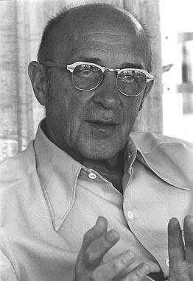
Humanistic &
Person-Centered Therapy
Source of Pathology
Goals
Carl Rogers
Techniques
Non-directive
Unconditional Positive Regard
Notes:
This slide introduces humanistic and person-centered forms of therapy.
(Click) Source of Pathology
Proponents of humanistic and person-centered therapy (PCT) believe that mental health problems result from an inconsistency between patients’ behavior and their true personal identity.
(Click) Goals
The goals of PCT are to create conditions under which patients can discover their self-worth, feel comfortable exploring their own identity, and alter their behavior to better reflect this identity.
(Click) Carl Rogers
Carl Rogers (pictured) is considered the founding father of PCT, which he developed in the mid-20th century, amidst the growth of humanistic theory and human potential movements. Rogers believed that all people had the potential to change and that the role of therapists was to foster self-understanding and provide an environment in which adaptive change was most likely to occur.
(Click) Techniques
Non-directive: Rogers’s original name for PCT was non-directive therapy, which is reflected in the flexibility of PCT. Therapists do not try to change patients’ thoughts or behaviors directly. Rather, their role is to provide the therapeutic relationship as a comfortable platform for personal growth.
(Click) Unconditional Positive Regard: An important aspect of this relationship is the therapists’ expression of warmth and empathy toward the patient, creating an environment free of approval or disapproval, where patients feel free to behave in ways that are congruent with their own identity.
Click the “Techniques” hyperlink in the slide to view a video example of Carl Rogers administering his PCT technique.
(The video is approximately 10 minutes; however, if time does not permit a full viewing, students can get a basic understanding of Rogers’ method during the first 4-5 minutes of the video.)
Like psychoanalysis there are distinct advantages and disadvantages of person-centered therapy. A key advantage of person-centered therapy is that it is highly acceptable to patients. Also, PCT has themes that carryover well into other therapies.
The main disadvantage to PCT is that findings about its effectiveness are mixed, possibly because the treatment is primarily based on unspecific treatment factors

Slide 15
Humanistic &
Person-Centered Therapy
Advantages
Acceptable to patients
Translates to other approaches
Disadvantages
Mixed findings about effectiveness
Notes:
This slide continues the discussion of humanistic and person-centered forms of therapy.
Like psychoanalysis there are distinct advantages and disadvantages of person-centered therapy.
(Click) Advantages
A key advantage of person-centered therapy is that it is highly acceptable to patients.
Also, PCT has themes that carryover well into other therapies.
(Click) Disadvantages
The main disadvantage to PCT is that findings about its effectiveness are mixed, possibly because the treatment is primarily based on unspecific treatment factors (e.g., establishing a positive relationship with the patient).
It doesn’t directly target mental problems.

Slide 16
Overview
Introduction
Psychoanalysis and Psychodynamic Therapy
  Activity
Humanistic & Person-Centered Therapy
Cognitive Behavioral Therapy
  Activity
Acceptance and Mindfulness Approaches
Other Therapeutic Techniques
Notes:
This slide provides an overview of the material that will be covered during the lecture.

Slide 17
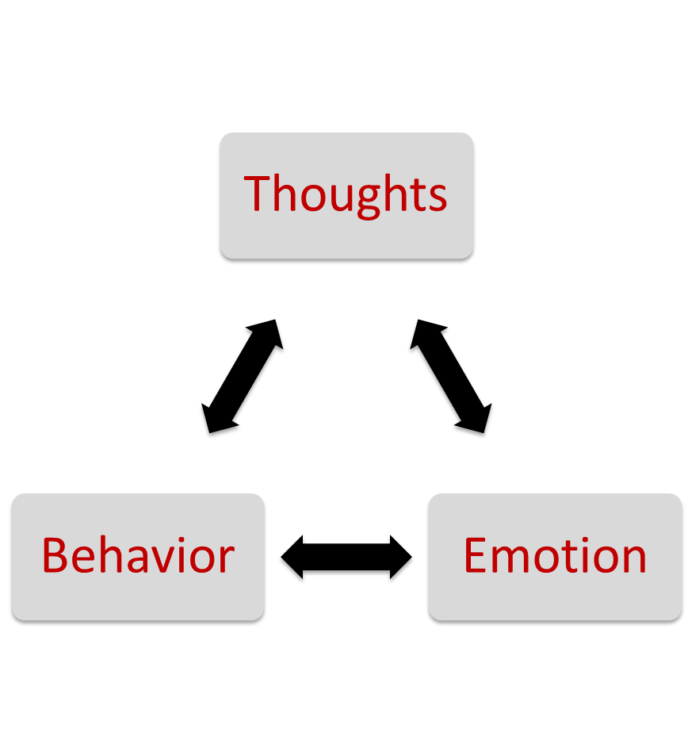
Cognitive Behavioral Therapy
Underlying conditions
Present-focused, brief, & effective
Founders:
Aaron Beck
Albert Ellis
Notes:
This slide introduces students to the goals, focus, duration, and efficacy of Cognitive Behavior Therapy.
Lecture Info:
Cognitive-behavioral therapy refers to a family of therapeutic approaches that focus on underlying cognitions and behaviors. The premise of CBT is that thoughts, behaviors, and emotions interact and contribute to psychopathology.
CBT is present-focused, based on behaviorally operationalized goals, and often involves between-session homework assignments. CBT is relatively brief—12 to 16 weekly sessions—closely tailored to treatment of the psychopathology, and has been shown to be highly effective.
CBT was developed in the mid-20th century by Dr. Aaron T. Beck, a psychiatrist, and Albert Ellis, a psychologist. Click the “Albert Ellis” hyperlink in the slide to view a video example of Albert Ellis administering his CBT technique.
Follow-up Question: What did you notice between Rogers’ and Ellis’ styles of therapy?
Students may indicate that Ellis was more direct and challenging, but less supportive than Rogers.

Slide 18
Cognitive Behavioral Therapy
Concepts
Automatic Thoughts
Schemas
The
Self
The World
The Future
Notes:
This slide introduces the concepts used in CBT.
Lecture Info:
“Automatic thoughts” refers to the thoughts that depressed patients report experiencing spontaneously.
These thoughts are believed to arise from three schemas.
“Schemas” refers to belief systems about the self, about the world, and about the future.

Slide 19

Cognitive Behavioral Therapy
Techniques
Cognitive Restructuring
Exposure Therapy
What disorders?
Notes:
This slide introduces the techniques used in CBT.
Lecture Info:
Cognitive restructuring involves helping patients identify maladaptive appraisals—those that were unhelpful or contributed to a mental health problem—and substitute more adaptive appraisals.
Exposure therapy involves having a patient confront a problematic situation instead of avoiding it, thereby reducing the fear associated with the situation through extinction learning—a neurobiological and cognitive process by which the patient “unlearns” the irrational fear.
Example Image: In the picture, the elevator represents a phobia that can be treated with exposure therapy. The patient builds confidence and control by taking frequent short trips in an elevator and slowly building toward longer trips.
(Click) Discussion Question: What are some psychological disorders that exposure therapy might be helpful in overcoming?
Some example situations exposure therapy is used in are PTSD, OCD, phobias, etc.

Slide 20
Cognitive Behavioral Therapy
Advantages
Brief
Proven effectiveness
Disadvantage
More patient effort
Notes:
This slide presents advantages and disadvantages of CBT.
Lecture Info:
Advantages:
CBT interventions tend to be relatively brief, making them cost-effective for the average consumer.
CBT is an intuitive treatment that makes logical sense to patients, and can be adapted to suit the needs of many different populations.
The greatest strength of CBT is the abundance of empirical support for its effectiveness. Studies have consistently found CBT to be equally or more effective than other forms of treatment, including medication and other therapies.
Disadvantage:
The downside of CBT is that it involves significant effort on the patient’s part. Therapists often assign “homework” between sessions to maintain the cognitive and behavioral habits the patient is working on.

Slide 21
The Way We Think Activity
I often worry that I _________. (fill in the blank)
If this worry of yours was indeed true, what does it mean to you and why does it bother you so much?
What's the worst thing that could possibly happen? What do you fear most of all?
When you think of the worst thing that could happen, do you really think that it's likely to happen? If so, how could you learn to cope with it?
What do I (perhaps "secretly") get out of thinking like this? How does it work to my advantage?
Persuade a Friend
I accept myself even though I __________ (do not use the word "am")
Notes:
Activity: The Way We Think—Examples of Cognitive Behavioral Therapy Techniques (15 – 20 min; feel free to limit the amount of prompts according to time constraints)
This activity exposes the students directly to various types of cognitive behavioral therapy techniques.
This is a writing activity, so ask students to take out paper and something to write with. (For detailed instructions see IM > Unit Therapies > Module 1: Therapeutic Orientations > Activities/Demonstrations.)
Cycle through the questions on the slide by clicking the mouse or using the forward arrow key.

Slide 22
Overview
Introduction
Psychoanalysis and Psychodynamic Therapy
  Activity
Humanistic & Person-Centered Therapy
Cognitive Behavioral Therapy
  Activity
Acceptance and Mindfulness Approaches
Other Therapeutic Techniques
Notes:
This slide provides an overview of the material that will be covered during the lecture.

Slide 23

Acceptance &
Mindfulness-Based Approaches
Mindfulness-based
Therapy Techniques
Mindfulness-based stress reduction (MBSR)
Mindfulness-based cognitive therapy (MBCT)
Notes:
This slide presents the techniques of acceptance and mindfulness-based approaches.
Lecture Info:
Mindfulness is a process that reflects a nonjudgmental, yet attentive, mental state. In a mindful state, one is very aware of bodily sensations, thoughts, and the outside environment, and this awareness is accompanied by nonjudgmental acceptance.
Techniques used in mindfulness-based therapy include:
Mindfulness-based stress reduction (MBSR), which uses meditation, yoga, and attention to physical experiences to reduce stress.
Mindfulness-based cognitive therapy (MBCT), which focuses on thoughts and their associated emotions.
These treatments have been used to address a wide range of illnesses, including depression, anxiety, chronic pain, coronary artery disease, and fibromyalgia.

Slide 24
Acceptance &
Mindfulness-Based Approaches
Self-Awareness
Self-regulation of attention
Orientation toward the present moment
Other Techniques
Dialectical behavior therapy (DBT)
Acceptance and commitment therapy (ACT)
Notes:
This slide presents the components of acceptance and mindfulness-based approaches.
Self-regulation of attention and orientation to the present moment are extremely important to a mindful-based approach.
Other techniques that use a mindful approach include:
Dialectical behavior therapy (DBT), used in some cognitive behavioral therapies (CBTs) to treat borderline personality disorder; DBT is founded on the dialectical worldview of incorporating both acceptance and change in the therapeutic process.
Acceptance and commitment therapy (ACT), based on Skinnerian behaviorism, teaches patients to observe their thoughts from a detached perspective. ACT encourages patients not to attempt changing or avoiding what thoughts and emotions they observe within themselves.

Slide 25

Acceptance &
Mindfulness-Based Approaches
Advantages
Acceptability
Accessibility
Disadvantage
Limited efficacy?
Notes:
This slide explains the advantages and disadvantages of mindfulness-based therapy.
Lecture Info:
Advantages:
Mindfulness-based therapy has a high acceptability and accessibility to patients. Because yoga and meditation are common to popular culture, mindfulness-based psychological techniques are already generally familiar.
Disadvantage:
The sole disadvantage of acceptance and mindfulness-based approaches is the lack of a consensus on their efficacy. However, growing evidence supports their effectiveness for treating mood and anxiety disorders.

Slide 26
Overview
Introduction
Psychoanalysis and Psychodynamic Therapy
  Activity
Humanistic & Person-Centered Therapy
Cognitive Behavioral Therapy
  Activity
Acceptance and Mindfulness Approaches
Other Therapeutic Techniques
Notes:
This slide provides an overview of the material that will be covered during the lecture.

Slide 27
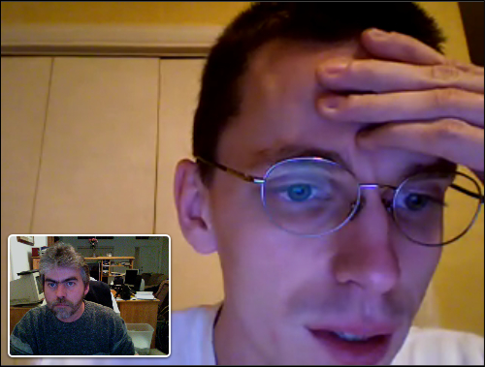
Other approaches to and Emerging Treatments
Internet & mobile-delivered therapies
Cognitive bias modification
CBT-enhancing pharmaceutical agents
Medications
Integrative/Eclectic
Notes:
This slide emphasizes the ever-changing nature of psychology as research continues to inform practice.
Advancements in research and technology in recent years have allowed psychologists to develop new treatment strategies. Often, these approaches focus on enhancing existing treatments, such as cognitive-behavioral therapies. For example:
(Click) Internet & mobile-delivered therapies
Smartphones and online technology make psychological treatments more accessible. Clinician-supervised online CBT modules allow patients to access treatment from home on their own schedule. This is particularly important for patients with less geographic or socioeconomic access to traditional treatments. Smartphones allow for symptom tracking, homework reminders, and more frequent therapist contact.
(Click) Cognitive bias modification
Therapy includes exercises aimed at changing patients’ problematic thought processes. Similar to internet and mobile-delivered therapies, cognitive bias modification might use a computer game to train alcohol abusers to avoid stimuli related to alcohol, or train socially anxious patients to interpret social stimuli positively.
(Click) CBT-enhancing pharmaceutical agents
CBT-enhancing pharmaceutical agents are drugs used to improve the effects of therapy. Findings from animal experiments have shown that certain drugs that influence the biological processes involved in learning can enhance the efficacy of some psychotherapies.
(Click) Medications
Psychiatric medications are frequently used as a treatment for mental disorders, including schizophrenia, bipolar disorder, depression, and anxiety disorders. Drugs are commonly used because they can be prescribed by general practitioners, whereas only trained professionals are qualified to deliver effective psychotherapy.
(Click) Finally, it is common for clinicians to identify their approach as either integrative or eclectic, meaning they incorporate several techniques into therapy.
Further Explanation: While drugs and CBT therapists tend to be almost equally effective, choosing the best intervention depends on a variety of factors, such as treatment availability and comorbidity—having multiple disorders simultaneously.

Slide 28
Photo Attribution
Slide 1 | Photo Credit: http://commons.wikimedia.org/wiki/File:Inkblot.png http://en.wikipedia.org/wiki/public_domain
Slide 3 | Photo Credit: http://commons.wikimedia.org/wiki/File:MANNA_Counseling.jpg http://creativecommons.org/licenses/by-sa/3.0/deed.en
Slide 5 | Photo Credit: http://commons.wikimedia.org/wiki/File:Sigmund_Freud_1926.jpg http://en.wikipedia.org/wiki/public_domain
Slide 19 & 20 | Photo Credit: Steve Cherches https://www.flickr.com/photos/38365639@N07/3537627917/ https://creativecommons.org/licenses/by-nc/2.0/
Slide 23 & 24 | Photo Credit: wmacphail https://www.flickr.com/photos/44124366667@N01/5712586185/ https://creativecommons.org/licenses/by-nc-sa/2.0/
Slide 25 | Photo Credit: rachaelvbender https://www.flickr.com/photos/67450533@N03/13878087124/ https://creativecommons.org/licenses/by-nc/2.0/
Slide 27 | Photo Credit: rbieber https://www.flickr.com/photos/48997036@N00/3205235536/ https://creativecommons.org/licenses/by-nc-nd/2.0/

